Slide 1
C++ slides - I
Objects and Classes: Structure in C and C++, Class specification, Objects, Data hiding, Encapsulation and abstraction, namespaces, Array of objects, Passing objects as arguments, Returning object from a function, inline functions, Static data member and member function, ‘const’ member function.

Slide 2
Basic program
#include<iostream>
using namespace std;
int main(){
cout<<"Hello world"<<endl;
}

Slide 3
cin & cout
cout works similar to printf
cin works similar to scanf
Example
cout<<“Hello and welcome”;
cin>>variable; //variable could be int, float, char array (without space)

Slide 4
cout basics
‘\n’ is for new line, or you can use endl
cout << endl << “message”;
‘\t’ is for tab
‘\a’ is an alarm sound
‘\r’ is carriage return to go to the beginning of the current line

Slide 5
Input char array with blanks
#include<iostream>
using namespace std;
int main(){
char str[20];
cin.getline(str,sizeof(str));
cout<<str<<endl;
}

Slide 6
Header files and namespace

Slide 7
Header file and more
#include <iostream> // input-output stream for cin/cout
using namespace std;
Namespaces allow us to differentiate same named entities in various libraries. It is just a region of the code or library and not a function.
std stands for standard I/O on the console screen.

Slide 8
Need of namespace
#include <iostream>
int main() {
int value;
value = 0;
double value; // Error here due to reuse of value
value = 0.0;
}

Slide 9
Example – namespace defines the scope
#include <iostream>
using namespace std;
namespace ns1 { int value() {return 5;}}
namespace ns2 { int value() {return -5;}}
int main() {
cout << ns1::value() << '\n'; //5 will be displayed
cout << ns2::value() << '\n'; // -5 will be displayed
}

Slide 10
What will be the output?
#include <iostream>
using namespace std;
namespace ns1 { int value() {return 5;}}
namespace ns2 { int x=10; int value() {return 4;}}
int main() {
cout << ns1::value() << endl;
cout << ns2::value() << endl;
cout<< ns2::x<<endl;
}

Slide 11
Without namespace could cause :: pollution
#include<iostream>
int main(){
std::cout << “Hello there” << std::endl;
return 0;
}

Slide 12
using namespace std;
Thus using namespace std; means cin/cout will be performed through standard console screen.

Slide 13
Header file and namespace
#include<iostream> includes all necessary files required of CIN and COUT opertions.
using namespace std; allows us to reduce :: pollution for simpler programs

Slide 14
Classes in C++
Class: A class in C++ is the building block of object oriented programming
It is User Defined Datatype (UDT) which has data & functions
Object is an instance of a Class i.e. variable of UDT.

Slide 15
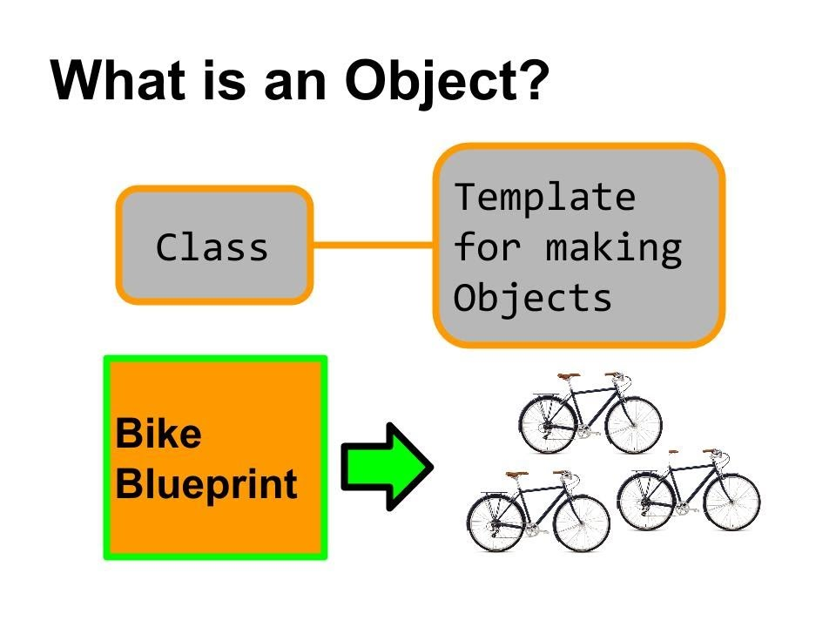

Slide 17
Structure in C++
#include <iostream>
using namespace std;
struct Person{int age;};
int main(){
Person p1; // No need to write struct Person p1 in C++.
cout << "Enter age: ";cin >> p1.age;
cout <<"Age: " << p1.age << endl;
return 0;
}

Slide 18
Structures in C++ vs in C
Functions can be defined inside structure in C++
Using struct keyword not required in C++
C++ structures can have static members
C++ allows data hiding by using access modifiers

Slide 19
#include <iostream>
using namespace std;
struct Person{
int age; //variable
int setAge(int a){age = a;} //function
int display() {cout <<"Age: " << age << endl;} //function
};
int main(){
Person p1;
p1.setAge(20); p1.display();
return 0;
}

Slide 20
Need more knowledge for 3 & 4
Functions can be defined inside structure in C++
Using struct keyword not required in C++
C++ structures can have static members
C++ allows data hiding by using access modifiers

Slide 21


Classes in C++ are similar to struct for syntax
struct – everything is public by default
class – everything is private by default.

Slide 22
What is the output of the following program?

Slide 23
#include <iostream>
using namespace std;
class Person{
int age;
int setAge(int a){age = a;}
int display() {cout <<"Age: " << age << endl;}
};
int main(){
Person p1;
p1.setAge(20); p1.display();
return 0;
}

Slide 24
Answer - Output – Compilation Error
[Error] 'int Person::setAge(int)' is private

Slide 25
Now we use public: specifier for data and functions in class

Slide 26
#include <iostream>
using namespace std;
class Person{
public: // Everything after public: becomes public
int age;
int setAge(int a){age = a;}
int display() {cout <<"Age: " << age << endl;}
};
int main(){
Person p1; p1.setAge(20);
p1.display(); return 0;
} // everything public in class means it becomes a struct

Slide 27
Output = Age: 20

Slide 28
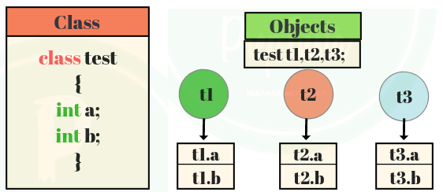
Each object has its own variables/functions

Slide 29
Access specifiers in C++
Public
Private
Protected (for later until we cover inheritance)

Slide 30
Data private and functions public. What will be the output of following program?

Slide 31
#include <iostream>
using namespace std;
class Person{
int age;
public: // Everything before public: is private
void setAge(int a){age = a;}
int display() {cout <<"Age: " << age << endl;}
};
int main(){
Person p1; p1.setAge(20);
p1.display(); return 0;
}

Slide 32
#include <iostream>
using namespace std;
class Person{
int age;
public:
void setAge(int a){age = a;} //setter function
int getAge() {return age;} //getter function
};
int main(){
Person p1; p1.setAge(20);
cout <<"Age: " << p1.getAge() << endl;
}

Slide 33
C++ versus C language

Slide 34
Sr. | C language | C++
1 | Functions are basic elements | Classes are basic elements
2 | Focus on global functions | Focus on encapsulation (data+functions)
3 | Functions share global data | Data and function access is controlled
4 | Data moves openly | Data is bounded with classes
5 | Top down approach (break down into functions) | Bottom up (clubbing of data and functions together)

Slide 35
Four features of object oriented programming
Encapsulation
Abstraction
Inheritance
Polymorphism

Slide 37
Encapsulation

Slide 38
Abstraction

Slide 39
Inheritance

Slide 40
Polymorphism – late binding flexibility

Slide 41
:: for global variable
#include<iostream>
using namespace std;
int x=100;
int main(){
int x=-100;
cout<<"x = "<<x<<endl;
cout<<"x = "<<::x<<endl;
return 0;
}

Slide 42
:: for function def
class A{
public: void fun(); //only declaration
};
void A::fun(){ //function definition
cout<<"in fun()"<<endl;
}
int main(){
A obj; obj.fun();
}

Slide 43
Constructor and Destructor functions
Constructor/Destructor is a member function which has to be public.
They are called automatically to construct (initialize) and destruct (delete) the object variables.

Slide 44
Constructor - basics
Same name as the class
No return statement
Automatically called when object is created
Compiler uses default empty constructor if no constructor is defined

Slide 45
Destructor
C++ destructors are used to de-allocate the memory allotted by constructor.
It has same name as class preceded by a tilde sign ~

Slide 46
Basic constructor and destructor
class Test {
public:
Test() {cout<<“in constructor”<<endl;}
~Test() { cout << “In destructor” << endl; }
};
int main() {
Test c; cout <<“In main”<<endl;;
}

Slide 47
Static variable in Class
class X{
static int i;
public:void show(){cout<<"i ="<<i<<endl;}
};
int X::i=1;
int main(){
X obj; obj.show();
}

Slide 48
Static function in Class
class X {
public:
static void f(){cout<<"In static f()"<<endl;}
};
int main(){
X::f(); // direct call without an object
}

Slide 49
Array of objects
#include<iostream>
using namespace std;
class A{
int a; char c;
};
int main(){
A a[3]; // each of a[i] will have an int and a char
}

Slide 50
Passing and returning an object
class A{
int i;
public: A(){i=10;}
void show(){cout<<"i = "<<i<<endl;}
A makedouble(A obj){A temp; temp.i = 2*obj.i; return temp;}
};
int main(){
A a1,a2; a1.show(); a2 = a1.makedouble(a1); a2.show();
}

Slide 51
Inline functions
inline int cube(int s){ return s*s*s; }
int main() {
cout << "The cube of 3 is: " << cube(3) << endl;
}

Slide 52
Inline function properties
Reduces function-call overhead
Asks the compiler to copy code into program instead of using function call
Compiler can ignore inline
Should be used for small, often used functions

Slide 53
‘const’ member function
int main(){
const int i = 10;
const int j = i + 10; // works fine
i++; // this leads to Compile time error
}

Slide 54
Const class variable
class Test{
const int i;
public:
Test(int x):i(x) {} //initialized using constructor
void show(){cout<<"i="<<i<<endl;}
};
int main(){Test t(190);t.show(); }

Slide 55
Const function
The idea of const functions is not to allow them to modify the object on which they are called.
It is recommended to make as many functions const as possible so that accidental changes to objects are avoided.

Slide 56
Const class member function
class A{
public: int x;
void func() const{
x = 0; // [Error] can’t modify object variable
}
};
int main(){}

Slide 57
Extra concepts
Const function and object

Slide 58
const function should be a member function
#include<iostream>
using namespace std;
int i = 99;
void fun() const{}
int main(){}
//What will be the output?

Slide 59
Output
[Error] non-member function 'void fun()' cannot have cv-qualifier
Since there is no class where this function belongs to, you will get an error.

Slide 60
const class object
In const class object, member variables cannot be modified
Calling member functions that change the value of member variables is also prohibited.

Slide 61
// Example of const object
class Test{
public:
int i;
Test(): i(0) {}
void setValue(int a) { i=a;}
};
int main(){
const Test t; // calls default constructor
//t.i = 5; // [Error]
//t.setValue(5); // [Error]
}

Slide 62
String basics - 1
int main(){
string name;
cout<<"Enter name: ";
getline(cin,name); // cin>>name; will only take first word
if(name.compare("rocky sharma")==0)
cout<<"Same"<<endl;
else cout<<"Different"<<endl;
}

Slide 63
String concat (connect)
int main(){
string name1,name2;
cout<<"string 1: "; cin>>name1;
cout<<"string 2: "; cin>>name2;
cout<<"String concat = "<<name1+", "+ name2;
}
// + means connect strings together

